Slide 1



Supporting Common Core Implementation:
Ensuring Aligned and Effective Instructional Materials for the Common Core
Webinar #2
May 27, 2014
1:00-2:15pm ET

Slide 2
WELCOME
Notes:
GFE (plus comments on series and ReadyTalk platform)

Slide 3
Founded in 1995, Grantmakers for Education is a membership organization of hundreds of grantmaking organizations across the nation working to improve outcomes and expand opportunities for learners across the education spectrum, from early learning through postsecondary and workforce development. Our mission is to strengthen philanthropy's capacity to improve educational outcomes and opportunities for all students. To accomplish this goal, we help foundation leaders and staff become more effective grantmakers by boosting their knowledge and their networks.
Gregg Behr
The Grable
Foundation
Cristina Huezo
W. Clement &
Jessie V. Stone
Foundation
Barbara Reisman
The Schumann
Fund for New Jersey
GFE is governed by a 12-member volunteer board of directors comprised of active foundation trustees and staff. Anne Stanton of the James Irvine Foundation is the current Chair and President of the organization, and Ana Tilton serves as GFE’s Executive Director.
Chair:
Anne Stanton
The James
Irvine Foundation
Nick Donohue
Nellie Mae
Education
Foundation
Barbara H. McAllister
Intel Foundation
Cassie Schwerner
The Schott
Foundation for
Public Education
Vice-Chair:
Wynn Rosser
Greater Texas
Foundation
Dominik Mjartan
Southern Bancorp Inc.
Tina Gridiron
Lumina
Foundation
Lee Parker
The Community
Foundation for the
National Capital Region
Lisa Villarreal
The San
Francisco
Foundation

Slide 4
Webinar Agenda
AGENDA ITEM
Welcome Ana Tilton—Executive Director, Grantmakers for Education
Introduction and Context Denis Udall– Program Officer, William and Flora Hewlett Foundation
What Do We Know about Efforts to Identify High Quality Instructional Materials? Bill Schmidt– University Distinguished Professor, Michigan State University Amy Deslattes—Instructional Strategist, Lafayette High School
Facilitated Questions and Answers: Panelists and CCFWG Issue Team Facilitated by Rachel Norman– Program Officer, The Leona M. and Harry B. Helmsley Charitable Trust
Update on Other Efforts in the Field Rachel Norman
Closing: What is our role in supporting High Quality Instructional Materials? Facilitated by Rachel Norman
Notes:
Welcome: Ana Tilton (3 minutes)
Welcome: Melissa Chabran (3 mins agenda and objectives) Denis Udall, Introduction and Context (10 minutes)
Introduce Presenters and Bill Schmidt: Denis
Presentations:
Bill Schmidt(15 minutes for talking)
Melissa Introduces Amy (1 minute)
Amy Deslattes(15 minutes talking)
Melissa Introduces Rachel (1 minute)
Facilitated Questions and Answers: Rachel (10 minutes)
Update on Other Efforts: Rachel Norman (5 minutes)
Facilitated Questions and Answers: Rachel (5 minutes)
Closing: Rachel Norman (5 minutes)

Slide 5
Webinar Objectives
As a result of participating in the program, funders will:
  Understand more deeply the importance of high quality instructional materials to support implementation of the Common Core
  Gain an awareness of various national and state efforts in the field to evaluate, identify and select materials
  Understand how we got to this moment in time: What is driving this issue and where are the strategic opportunities?
Notes:
Melissa runs through and introduces Denis.

Slide 6
INTRODUCTION
Notes:
Denis Udall gives background on CCFWG Issue Team and frames conversation
10 minutes

Slide 7

GOALS
Clearly identify the emerging/pressing needs and gaps as states and districts implement new standards and assessments
Match philanthropic resources with these gaps
Provide information to help individual funders strengthen their own grantmaking strategies as part of the shift to Common Core standards
Encourage coordinated grantmaking among funders with similar interests and strategies
Notes:
Denis Udall talking points:
The CCFWG has several goals that drive the work including:
providing resources and information to funders,
addressing gaps in the field and
encouraging coordinated grantmaking among funders with similar interests
Working Group identified the priorities and interests of different funders, to aid collaboration and hone in on gaps in the field needing additional attention. Emerged with two issue teams (Ensure high-quality, common core tools, materials and resources and Scale effective, common core professional development)
This webinar focuses on helping grantmakers understand the importance of identifying high-quality instructional materials and understanding efforts in the field

Slide 8
States that have Adopted Common Core
Has adopted both the math and English language arts standards
Has adopted only the English language arts standards
Has not adopted the standards
Has repealed its adoption of the standards
Notes:
We all know the importance of this “CCSS moment”—44.5 states (plus DC) adopting common standards that we hope will raise student achievement and create a new era of development of instructional materials on scale that was unthinkable because now 44.5 states (plus DC) share the same standards.
There are several big challenges with implementing the Core.
First, we know from several studies that the quality of standards, by themselves, can have a significant influence on student learning, but if we really want to get the biggest bang for the buck then we need to pay equal attention to all inputs that build on effective standards are high quality and are integrated into a seamless whole—professional development, teacher evaluation and instructional materials.

Slide 9

Notes:
With the adoption of the CCSS and the CCSS assessments due out this year, there’s been a lot of attention to testing, standards and accountability, and we’re starting to see a wide spread effort to increase teacher capacity to teach to these new standards, but oddly there’s been little focus on a key input—instructional materials and how teachers and students interact with them.

Slide 10


Notes:
The irony here is that it’s hard to over-estimate the impact of instructional materials on students’ learning.

Slide 11
Teachers Rely on Materials
50% of 4th graders do math problems every day from a textbook
70-98% of teachers use textbooks at least weekly
Instructional materials have an impact on student learning that’s as significant as teacher quality
Notes:
First, we know that teachers greatly rely on materials. For example (this is from a Brookings report), 50% of 4th graders do math problems every day from a textbook and 70-98% of teachers use textbooks at least weekly.
Second, there’s also strong evidence that the choice of instructional materials as a huge impact on student learning that’s as larger, or larger, than the impact of teacher quality.
But whereas improving teacher effectiveness is a pretty time consuming and expensive undertaking, making better choices about instructional materials should be less labor-intensive and expensive.
So one thing we’re not dealing with today is the effectiveness of instructional materials in increase student performance, which is a hugely complicated issue deserving its own session.
Instead, we’re going be exploring the alignment of instructional materials with the CCSS.
So it’s pretty clear that we need what districts, states and educators have been increasingly calling for:
we need an objective way for states and district to make wise choices about materials that are actually aligned to the common core
We need a clear criteria to teachers to develop and share curriculum and lessons that aligned with the CCSS; and
We need specific criteria that tells the publishing industry what CCSS –aligned materials look like
Without these there’s a very real fear that we won’t be able to deliver on the promise of the CCSS as a more rigorous, stronger and internationally benchmarked set of content standards.
So let’s now turn to Bill Schmidt and Amy Deslattes who are going to help us understand why it’s time to pay attention to the fact that instructional materials are likely to play a huge role in the success of the CCSS.

Slide 12


Presenters
Bill Schmidt
University Distinguished Professor, Michigan State University
Amy Deslattes
Instructional Strategist,
Lafayette High School
Notes:
Denis will go over the presenters and introduce Bill

Slide 13

Why Implementation Requires
Change
William Schmidt
University Distinguished Professor
Michigan State University

Slide 14
How Teachers Allocate Their Time

Slide 15

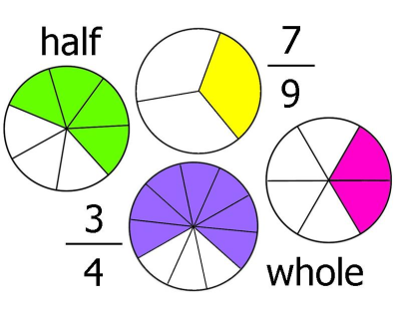


4th & 5th Teachers: Very Prepared to Teach?
75%
75%
Whole Numbers
Common Fractions
40%
22%
Number Sets
& Concepts
3D Geometry

Slide 16
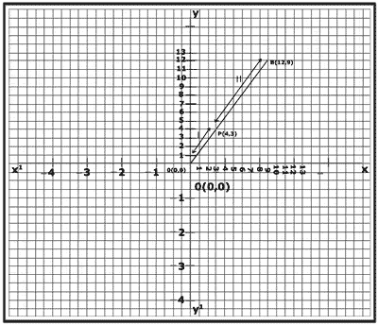

Middle School Teachers: Very Prepared to Teach?
70%
51%
Coordinates & Lines
Linear Equations
log₆ (2x-3) + log₆ (x+5) = log₃ (x)
log (2x-3) + log (x+5) = log (x)
log(6) log(6) log(3)
10%
Logarithmic Equations

Slide 17
Future Teachers Reaching International Benchmark
Russian
Federation
Chinese
Taipei
Percent reaching international benchmark
United
States

Slide 18
U.S. Future Teachers Reaching International Benchmark in Top and Low Performing Programs
Percent
reaching
international
benchmark
Top 25%
Performing Programs
Bottom 25%
Performing Programs

Slide 19
Alignment of One Text Book Series to the CCSSM

Slide 20
Coverage in Grades 2 and 5

Slide 21
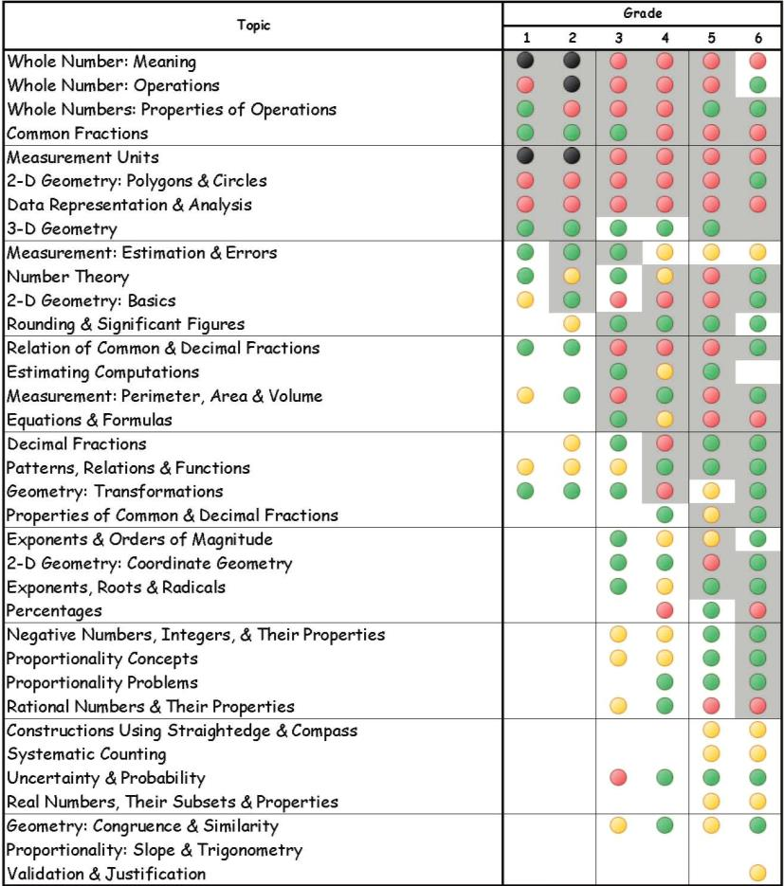
Coherence in the Same Textbook
Series

Slide 22
Allocation of Time from Three Sources

Slide 23
Amy Deslattes
Instructional Strategist
Lafayette High School
Notes:
Melissa will introduce Amy

Slide 24
Evaluating Instructional Materials:
The Work of Louisiana Teacher Leaders
Amy Deslattes

Slide 25
Louisiana Teacher Leader Advisors
Over 100 teachers from districts across the state
Experts in content field
Represent K-12, ELA, math, science, social studies
Application process:
  administrator/superintendent recommendations
  completion of performance task
Scope of Work:
  Creation of curriculum exemplars
  Creation of sample assessment pieces
  Review of instructional materials
Notes:
Teachers are the content experts who know best how students respond to the standards within instruction.
They can be the SEA’s greatest resource in identifying materials that are aligned to CCSS.

Slide 26
Instructional Material Review Process
Team Composition
  Content Area
  Grade Bands
Rubric Selection
  IMET
  EQuIP
Face-to-Face trainings
  Collaborative review of free, readily available resource (Engage NY)
  In-depth discussion of materials, rubrics, key indicators, non-negotiables
  Revision of rubric to align with departmental goals
  Team consensus of ratings based on evidence in texts
Notes:
This is a very different process from previous textbook material reviews. Teachers aren’t looking for the bells and whistles of the past, but instead want a curriculum that is truly aligned to the standards. We know this is going to be hard work for us as teachers, so we want a curriculum that is going to bring the appropriate texts and questions in order to make our work more efficient.
Working face-to-face is important for getting inter-rater reliablity, but working individually is equally important to get each reviewers most honest feedback.

Slide 27
Ongoing Review Process
Individual reviews by team members, followed by phone/email conferences within grade bands to maintain consensus
Additional face-to-face meetings
  Peer Review of completed evaluations
  Vocabulary and phrasing workshop for consistency
  Cross-curricular reviews to clarify “teacher speak”
SEA review and verification of consensus across major grade bands
Notes:
Constant communication is necessary since each curriculum provider has its own unique platform to host the materials. Reviewers can benefit from conference calls and group emails to make locating criteria easier.
Face-to-face meetings are still beneficial to creating consensus across grade bands
Math and ELA groups should review each other’s reviews to make sure the review is not filled with “teacher speak” that would not be familiar to publishers and/or rubric audiences (district personnel)
SEA liaison works with all grade bands to identify consensus across major grade clusters

Slide 28
Louisiana’s version of IMET
EQuIP rubric shortcomings in evaluating entire curriculum of materials
IMET rubric takes “all or nothing” approach
Louisiana’s revised version of IMET
  Assigning of tiers based on alignment to components in rubric
    Tier 1- meets all 10 criteria,
    Tier 2- meets all non-negotiables but may not meet one of the other criteria,
    Tier 3- does not meet all non-negotiables
  Subdivides Text Selection and Text Dependent Questions and Tasks categories to allow for better individual analysis of materials
  Limits non-negotiables to Complexity of Text, Quality of Text, Foundational Skills, and Text Dependent Questions
Notes:
Initial reviews conducted with EQuIP; created for lesson and unit lesson plans; not ideal for year-long curriculum
While IMET is ideal, it’s not realistic in this transitional time for curriculum companies.
The Louisiana approach of providing tiers was so that districts and teachers could make purchasing choices knowing exactly where they would have to supplement at the district or classroom level.
Most LA districts are considering curriculum that falls in Tier 1 or 2. They realize that Tier 3 would require too much revision at the classroom level to insure CCSS alignment.

Slide 29
Findings Across Multiple Reviews
Text Complexity rational is not always clear
Text selection in upper grades based around typical “favorites” rather than how the text can meet the standards
Increase in complexity over the course of the year is not always priority
Lack of targeted, careful instruction around meaningful shorter texts for close reading
Balance of literary and informational texts (non-narrative in upper levels)
Front loading of information via lecture/Powerpoint
Notes:
Many companies provided a text complexity “score” but the rational was not always clear. Why was text A the best choice for this unit and this standard?
We’ve taught linear literature in 11th and 12th grade for so long, that it we often include texts just because they are the expected representation of the time period.
Close reading can be embedded in the lesson, but few publishers are providing clear guidance for teachers. Which passage in this longer text is worthy of a re-read? Why? What text dependent questions are going to help my students dig deeper into this complex portion of text?
More activities should allow for student discovery of background information that was previously part of front loading and lecture.

Slide 30
Findings Across Multiple Reviews
Questions that stay at the comprehension level
Questions that don’t “guide” students through reading (specifically on cold-read assessments)
Little attention to academic vocabulary and analysis of author’s word choice
Ancillary materials have not gone through a thorough revision for CCSS alignment
Limited opportunity for writing to sources
No exemplars of embedded language instruction
Lack of opportunity for students to engage in speaking and listening around text
Notes:
Questions typically stay at surface level with only one or two that force students to dig deep.
On assessment pieces, students need to see more questions that guide them through a cold-read piece to give them the scaffolding they need before moving on to deep, analytical questions.
Students need to see more analysis of author’s word choice, including academic vocabulary. Even those publishers who include academic vocabulary are not always doing it in a meaningful way.
Many publishers have not thoroughly revised ancillary materials. We know that teachers turn to those ancillary unit guidebooks when creating their unit assessments, and if these have not been aligned to CCSS, then true alignment will not take place in the classroom.
CCSS provides great opportunity for connection among writing, language, speaking/listening standards, but this is not evidenced in curriculum.

Slide 31
Findings Across Multiple Reviews
Traditional publishers are beginning to understand the revisions necessary for CCSS alignment; most are at Tier 2 level
Teacher editions of traditional publishers are near alignment, while ancillary materials still require lengthy revisions
Self-paced, computer based curriculums are not making the necessary adjustments for alignment; most are Tier 3 and still have huge gaps to fill
No publishing company has successfully embedded the language standards, writing standards, and speaking/listening standards.
Notes:
Great concern about self-paced, “credit recovery” programs that are claiming CCSS alignment. It’s just not there.
No curriculums provided great examples of embedding language standards within the curriculum. Most were stand-alone mini-lessons that had little relation to the literature under consideration.

Slide 32



Slide 33
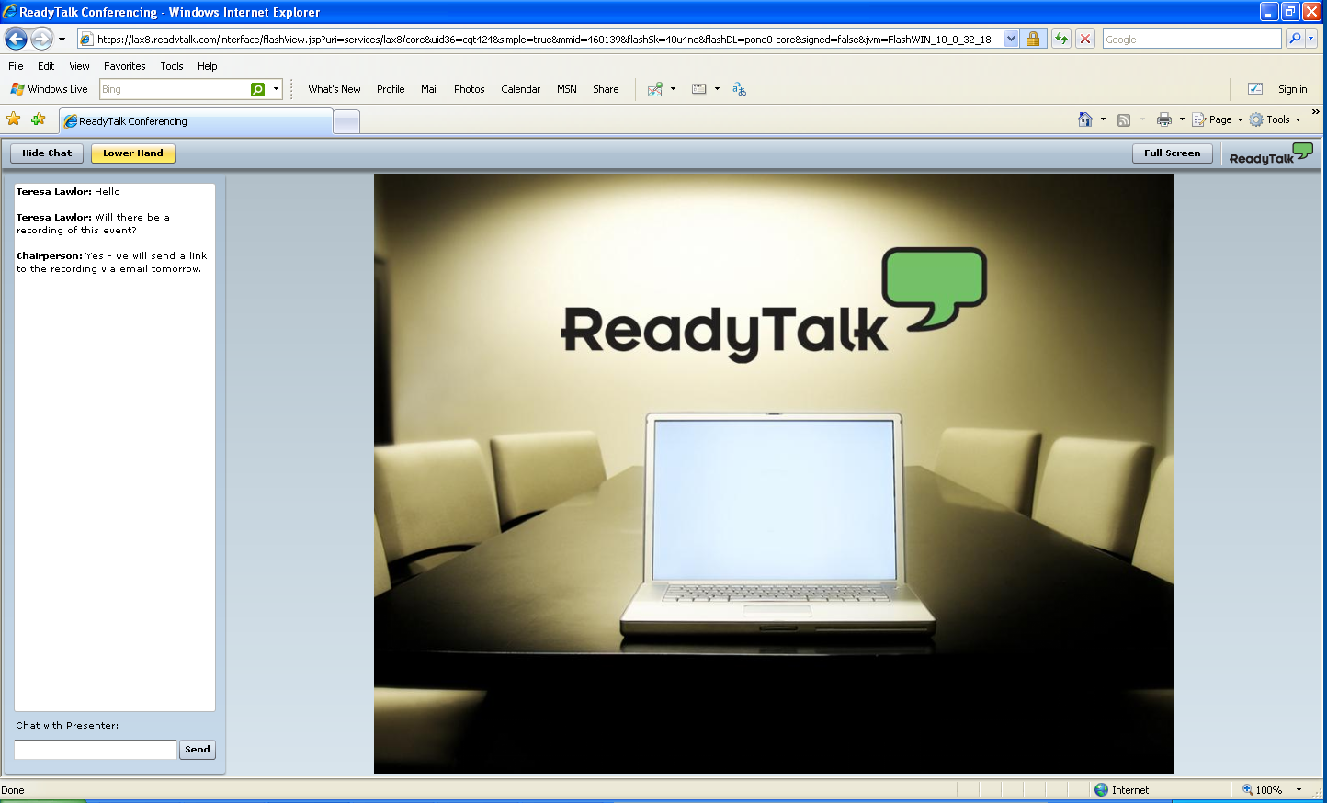
Participant Interface
Q&A
Type your question here and press ENTER

Slide 34




Other Efforts in the Field
Criteria for evaluating instructional materials
Instructional Materials Evaluation Tool (IMET), Student Achievement Partners
EQuIP, Achieve
Task Review Criteria, Illustrative Mathematics
Instructional Materials Analysis and Selection, The Charles A. Dana Center at the University of Texas at Austin
Notes:
Melissa will introduce Rachel
EdReports.org talking points:
One of the major barriers to effective Common Core implementation is the insufficient supply of high-quality, standards-aligned curriculum.
Now more than ever, these materials are crucial to educators' ability to bring the standards to life in classrooms.
This new organization, EdReports.org, aims to provide teachers, curriculum purchasers, and other key stakeholders with transparent, authoritative, "Consumer Reports"-style reviews of major mathematics textbooks and instructional content (including digital materials).
Overall, the nonprofit’s goal is to help teachers, principals and district leaders with curricular decisions and selection and give all teachers access to excellent curriculum.
EdReports.org is committed to building the organization with educators involved at every step. As usual, nothing important can happen in public education without the deep engagement of educators from design to implementation to continuous improvement.

Slide 35





Other Efforts in the Field
Sources of Vetted Instructional Materials
achievethecore.org, Student Achievement Partners
EQuIP exemplars, Achieve
engageny.org
louisianabelieves.com/academics
OER Commons
Evaluation and Ratings Platforms
  graphite.org
Coming soon

Slide 36
Summary and Closing
What Is Our Role in Supporting Common Core Aligned Instructional Materials?
Notes:
Rachel Norman
5 minutes

Slide 37
Locating Webinar Materials
http://www.edfunders.org/common-core

