Slide 1
An Exploration of
Social-Emotional Learning in Out-of-School Time
Presented by:
GFE’s Out-of-School Time Funder Network

Slide 2


Lisa Relou
Director of Strategies
Grantmakers for Education

Slide 3
Founded in 1995, Grantmakers for Education is a membership organization of hundreds of grantmaking organizations across the nation working to improve outcomes and expand opportunities for learners across the education spectrum, from early learning through postsecondary and workforce development. Our mission is to strengthen philanthropy's capacity to improve educational outcomes and opportunities for all students. To accomplish this goal, we help foundation leaders and staff become more effective grantmakers by boosting their knowledge and their networks.
Gregg Behr
The Grable
Foundation
Cristina Huezo
W. Clement &
Jessie V. Stone
Foundation
Barbara Reisman
The Schumann
Fund for New Jersey
GFE is governed by a 12-member volunteer board of directors comprised of active foundation trustees and staff. Anne Stanton of the James Irvine Foundation is the current Chair and President of the organization, and Ana Tilton serves as GFE’s Executive Director.
Chair:
Anne Stanton
The James
Irvine Foundation
Nick Donohue
Nellie Mae
Education
Foundation
Barbara H. McAllister
Intel Foundation
Cassie Schwerner
The Schott
Foundation for
Public Education
Vice-Chair:
Wynn Rosser
Greater Texas
Foundation
Dominik Mjartan
Southern Bancorp Inc.
Tina Gridiron
Lumina
Foundation
Lee Parker
The Community
Foundation for the
National Capital Region
Lisa Villarreal
The San
Francisco
Foundation

Slide 4
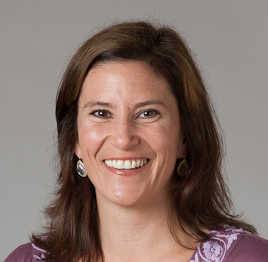
Celene Domitrovich
Director of Research
Collaborative for Academic, Social, and Emotional Learning (CASEL)
casel.org

Slide 5
Social and Emotional Learning (SEL)
SEL involves processes through which children and adults develop fundamental emotional and social skills:
  To understand and manage emotions
  Set and achieve positive goals
  Feel and show empathy for others
  Establish and maintain positive relationships
  Make responsible decisions

Slide 6
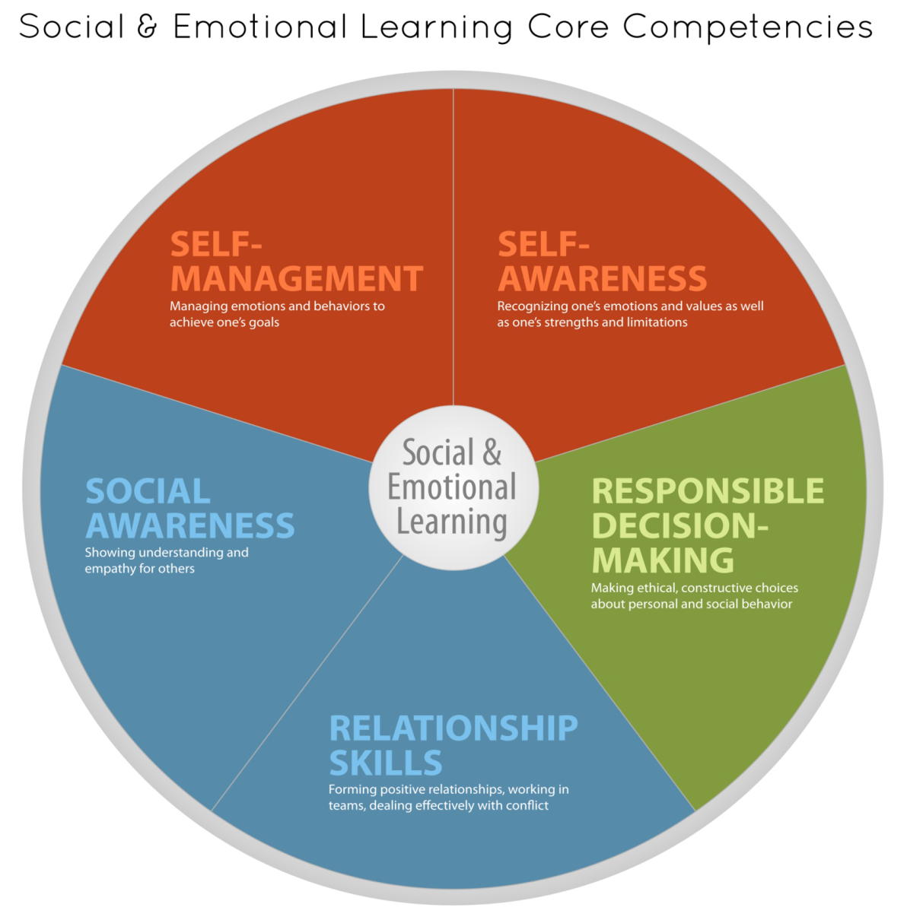

Slide 7
Focus of the Review
68 afterschool programs with data at post
Prior afterschool program reviews have not focused primarily on student social-emotional development
Large number of programs evaluated
68% of program reports appeared > 2001

Slide 8

Student Outcomes:
SAFE and OTHER Programs
Feelings and attitudes
  Child self-perceptions
  School bonding
Behavioral adjustment
  Positive social behaviors
  Problem behaviors
  Reduced drug use
School performance
  Attendance
  School grades
  Achievement test scores
SAFE programs:
Other programs:

Slide 9
SAFE Programs are Effective
Sequential: Sequenced activities to teach skills
Active: Active learning to practice skills
Focused: Focused time on skill development
Explicit: Explicit targeting of specific skills

Slide 10
Conclusions and Recommendations
Quality afterschool programs can improve a range of important student learning and developmental outcomes.
Programs that promote social-emotional development can also improve school performance.
If programs intend to be successful, both program content and process are important.
SAFE programs produce positive student outcomes.

Slide 11
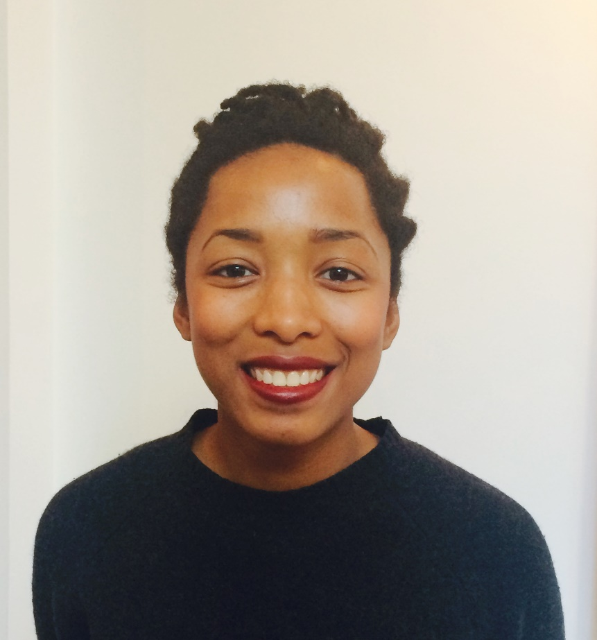
Hannah Baptiste
Program Associate
Susan Crown Exchange
scefdn.org

Slide 12

INVESTING IN SEL AFTERSCHOOL
Grantmakers for Education
Hannah Baptiste, SCE

Slide 13
SCE is a social investment organization that connects talent and innovation with market forces to drive social change.
Our initiatives in Digital Learning and Social and Emotional Learning aim to broaden and enrich opportunities for learning beyond academics and outside school walls.

Slide 14
SEL GRANTMAKING?
ELEVATE THE PRACTICES
We know that certain program features promote positive youth development. Less is known about the methods that leverage growth in particular domains of SEL.
IDENTIFY THE BEST TOOLS
SEL is not one size fits all. Particular social and emotional competencies likely require particular approaches. Linking specific methods to discrete skill growth, rather than to proxy indicators such as risk aversion, will drive adoption of the most valuable approaches.
MEASURE IMPACT
Link program experience to youth behavior change; assessing skill transfer across contexts and over time

Slide 15
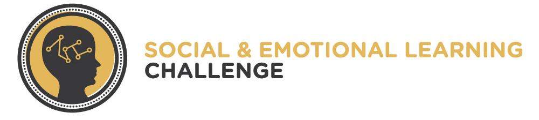
GOAL: To develop a practical theory of how social and emotional growth is nurtured in the OST context.
Why a Challenge grant? Why not traditional research?
  Discover unlikely partners
  Directly fund impactful, exceptional work
Defining SEL: SCE’s approach
  Keep open the pluralism
  Wellness: beyond academic outcomes
  Defer to the experts: youth workers

Slide 16
WHAT DOES SUCCESS LOOK LIKE?
“Field Guide” will provide OST workers, executives and policy makers resources for making SEL a more intentional component of programs
Raise profile of SEL as a valuable and integral component of youth service broadly
Catalyze smart investments in proven SEL approaches in broad and diverse fields serving adolescents

Slide 17


Slide 18
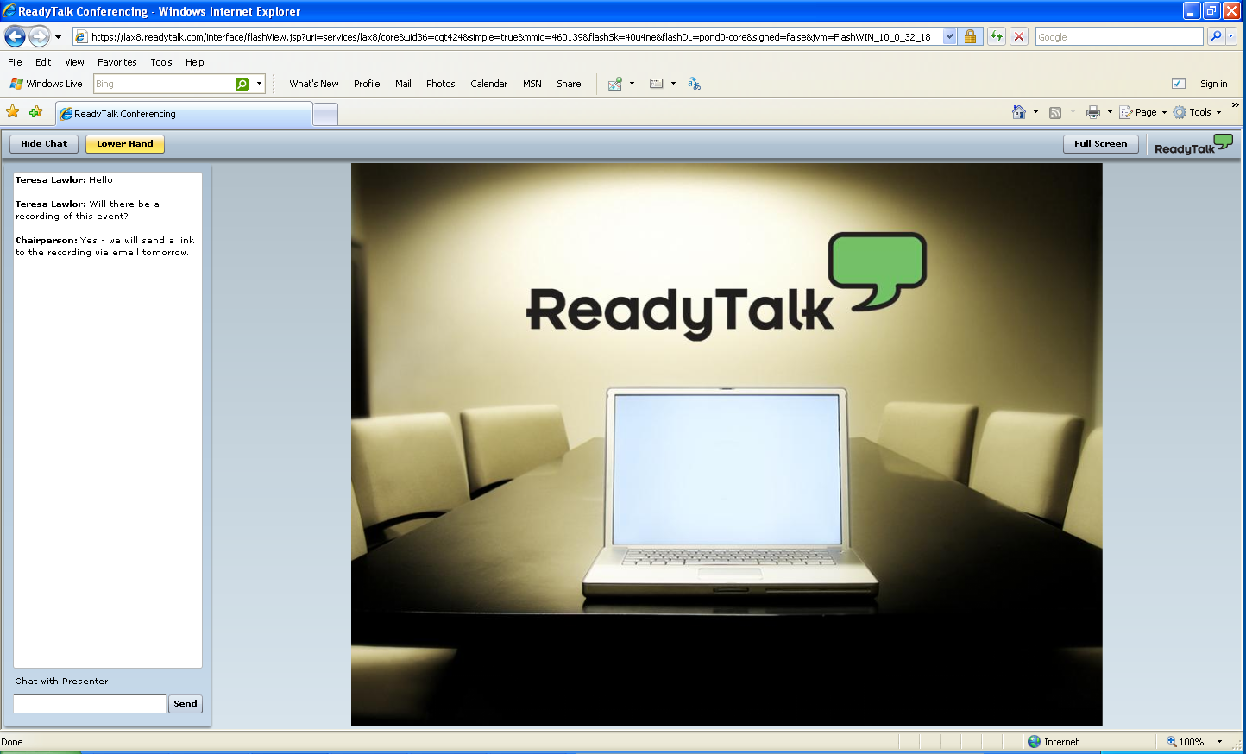
Participant Interface
Q&A
Type your question here and press ENTER

Slide 19
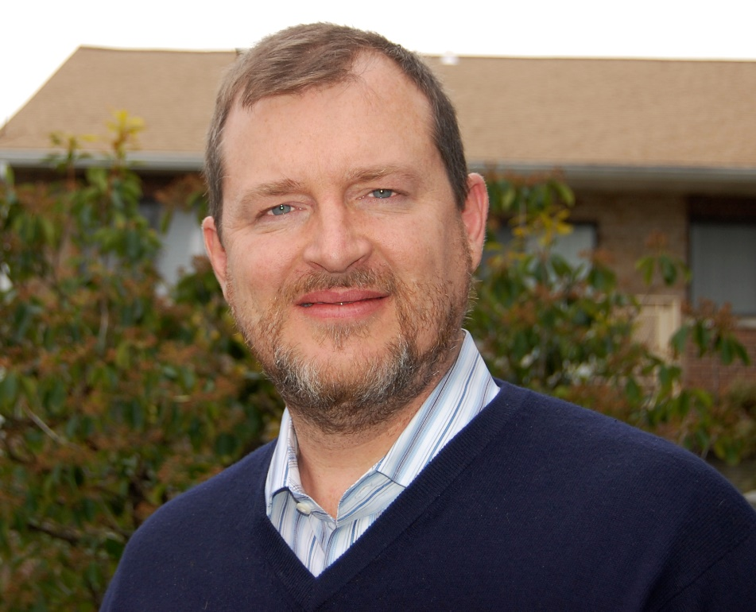
Charles Smith
Executive Director
David P. Weikart Center for Youth Program Quality
cypq.org

Slide 20
Effective Investment in SEL After School: Performance Improvement and Accountability Tools
Grantmakers for Education
Charles Smith, Ph.D., Weikart Center
April 15, 2014
Notes:
Introduction.
All of us move through the world based on set of beliefs about our selfs and beliefs about the world outside us and beliefs about how our self fits into that world. These schema’s are profoundly affected by our experiences, and how our experience interact with prior schema that we’ve already burned in. Afterschool programs are an opportunity to rewrite some of the existing schema and develop some important new ones. Here’s the challenge for a performance system – you have to measure things and it turns out that while what is going on inside a persons head – the mental objects of interest i.e., those schema – are clearly the most important thing to understand, the measurement of these objects has feasibility issues – so we end up measuring behavior instead. Think about the performance systems in early childhood education – while we’ve got the agreed upon measures for the mental objects associated with school readiness – PPVT, WJ – it’s the adult ratings of child behavior that get used in the performance systems – Child Observation Record, Work Sampling System, Brigance, Creative Curriculum Assessment. So the work of a performance system focused on SEL is first to identify the active ingredients for SEL (standards and skills), second to occasionally measure them in behavioral terms, and then 3rd use both sources of information to manage toward higher performance. Fortunately, the AS field has already got great infrastructure in place to do that so we basically just need to tweak our existing work to get more intentional performance around SEL.

Slide 21
How can funders improve SEL using performance improvement and accountability tools?
Focus on how skills grow
Set standards for best practice
Require continuous improvement
Build capacity of QISs and QIOs
[Align, crosswalk, translate – ongoing]
Practical Theory
Feasible
Measurement
Notes:
Four recommendations for Funders Investing in SEL Afterschool.
Focus on how skills grow: The shape of learning is scalloped rather than linear and requires practice, practice, practice. If we name behavioral indicators of SEL skills and ask staff how often youth get to actually encounter challenges and practice the SEL skills, it’s leads directly to a discussion of program design and staff practices. The mental objects (schema) are less actionable until they are aligned with observable behaviors.
Set standards for best practice: Good program standards are, in effect, “practical theories” that describe active ingredients aligned with levels/roles. This is part of the movement from evidence based programs to evidence based practices. We need better and clearer standards for point of service interactions – we’re almost talking about curricula here – that communicate critical program design elements, the staff practices that animate those designs and the behavioral indicators of skill practice that we expect to see in the kids. We also really need to be conscious of time: longer and shorter cycles and “hot” episodes. (See next slide)
Require continuous improvement: Continuous improvement (maybe along with attendance) should be the high stakes accountability in our field. Continuous improvement is the other side of moving to a standards driven or “evidence based practice” model – you have to be aware of how intensively you are implementing the best practices and how engaged the kids and staff are in the process. We are likely doing a lot of the right things, way too lightly to have substantively important effects. In practicality, we are already measuring SEL supports all over the afterschool field. I would argue that the PQA and APT and the CLASS and even parts of the SACERS are measures of SEL best practices. We now need to add feasible adult ratings of child behavior to really zero in on SEL and do the mix of theory testing, program evaluation and performance management work that we are all engaged in.
Build capacity of QISs and QIOs: The quality improvement systems and quality improvement organizations, QISs and QIOs, that are emerging in our field are the state of the art. They provide a set of technical and substantive supports that I believe are advanced in ways that the QRISs and teacher evaluation systems are often not. Investing in them is perhaps the most cost effective path for funders because they not only do the work but also attract additional resources to the work (See last slide).

Slide 22
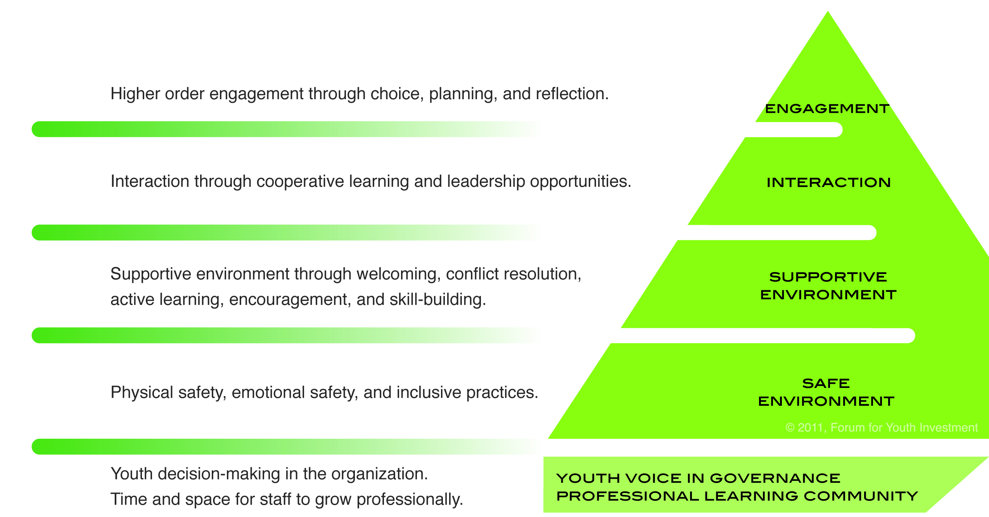
2) Set standards for best practices
Program Design: Arc of Learning and Work
Cumulative Short Arcs and Hot Episodes
Staff Daily Practice: Safety, Trust and Relationships at the “Base”
Notes:
Heath introduced arc of WORK – the long term projects that lead to authentic evaluation.
These combined findings suggest that
much of youth’s development of social and emotional skills involves youth’s active conscious learning from experiences in programs;
the types of learning experiences corresponding to different categories of socio-emotional skills (e.g. grit, responsibility, emotional skills) entail distinct cycles of learning. For example, the development of responsibility occurs through cycles of youth taking on roles, persevering through the challenges of those roles, and then incorporating their perseverance, accountability, and success into their self-concepts.
Effective programs are designed with logic models that facilitate youth’s experience of these cycles of learning.
Larson’s work further suggests that effective staff practices are shaped around staffs’ knowledge of these learning skills. Staff shape and respond to the unfolding of these experiences in ways that maximize youth’s learning, for example, by providing “emotion coaching” that helps youth learn skills for understanding and managing (and even using!) the peculiar dynamics of different emotions (such as anger, anxiety, and excitement).
Finally, effective staff are skilled at using unplanned events and situations in programs as opportunities for facilitating youth’s social emotional learning
(Larson & Walker, 2010, Walker & Larson, 2012).

Slide 23

4) Build capacity in QISs and QIOs
Sample of 69 cities over 100K stratified by size
77% are coordinating afterschool policies
91% of these worked on quality
44% of these developed shared data systems

Slide 25
Participant Interface
Q&A
Type your question here and press ENTER

Slide 26
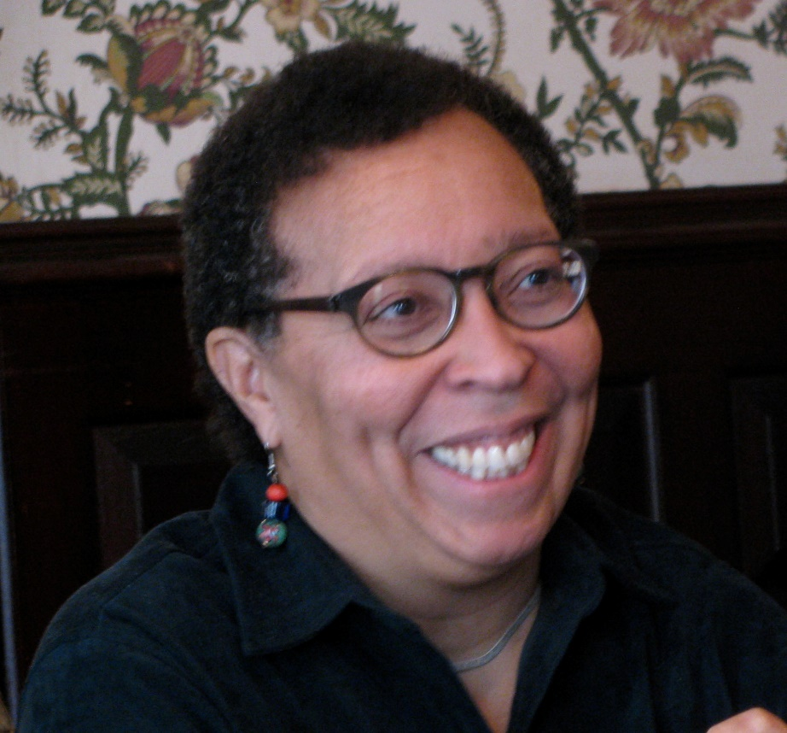
Karen Pittman
Co-Founder,
President and CEO
Forum for Youth Investment
forumfyi.org

Slide 27
Bridging Systems and Sectors to Improve Equitable Access to Quality SEL Experiences
Karen Pittman, CEO
The Forum for Youth Investment
Grantmakers for Education OST Webinar
April 15, 2014

Slide 28


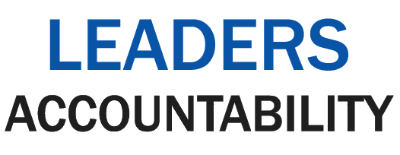


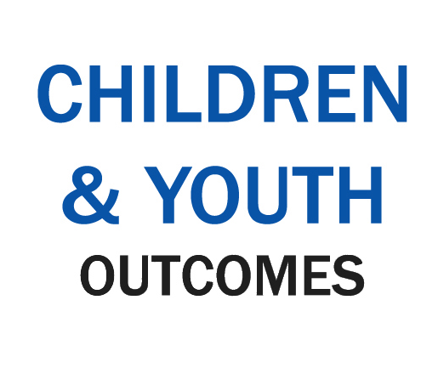
Standards. Solutions. Success.
Developmentally On Track Productive
Connected
Healthy & Safe
Partnerships
Goals
Data
Actions
Coordinated
Accessible
Well-Attended High Quality

Slide 29

An Easy Way to Think About Readiness
The Readiness Target
Notes:
You could ask for their input immediately, or do the slides and then ask at the end. Target comes back at the end.

Slide 30
The QuEST for Readiness
Transfer: Application of
Skills/beliefs in
new settings
Time & Practice in Setting:
Multiple sessions
Observation Setting: Point of service session
Quality:
Instruction, Content
Engagement:
Behavior, Flow
SEL Skill/Belief
Interpersonal, Intra personal, Cognitive
Transfer Outcome
Achievement, Behavior
Quality → Engagement → Skills → Transfer
QuEST
Notes:
So this is how we talk about child development with our clients and this is how we organize the jingle jangle jungle of research knowledge. You can see that engagement is inside the first concentric box. We define engagement as behavior and reports of interest with challenge. This is what we try to measure in our work.
Main thing to see is that when we use the word engagement we’re pretty in the moment. A sequence of those moments produces skill building. So really engagement and skill building are wrapped together for us.
One challenge is that every time you step outside of a box you get multi-finality – which is the challenge with a “broad developmentally focused intervention” model.
We’re really interested in what we can measure.

Slide 31
Where SEL Skills Matter
SEL
K-12 Schools
[Academic Credentials & Achievement]
Prevention Programs
[Risk Reduction]
Justice/Child Welfare
[Reduced Recidivism, Transition to Independence]
Workforce Training
[Employment Retention]
After School
Programs

Slide 32
The Real Readiness Challenge
If SEL Skills are critical to the achievement of broader public policy goals, the systems and settings responsible for those goals have three choices:
Continue business as usual and fail to meet accountability targets
Significantly revamp practice to support SEL skill development
Partner with practitioners who focus on SEL

Slide 33

DISCUSSION

Slide 34
Participant Interface
Q&A
Type your question here and press ENTER

Slide 35
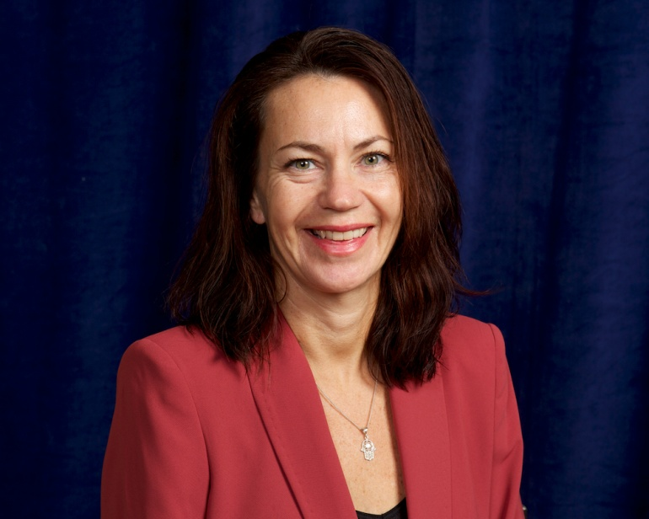
Kathleen Traphagen
Coordinator
GFE’s Out-of-School Time
Funder Network
ostnetwork@edfunders.org

Slide 36
The Grantmakers for Education Out-of-School Time Funder Network was created in 2009 as a forum within GFE for philanthropic organizations interested in increasing access to high-quality OST experiences for young people and building systemic supports to sustain the field. Our primary strategies include sharing knowledge and effective practices; forging collaborations among grantmakers; and building alliances with K-12 education reform, child development and well-being, and other aligned grantmaking communities.
Co-Chair:
Dara Rose
The Wallace
Foundation
Dale Anglin
Victoria
Foundation
Wayne Jones
The Heinz
Endowments
Jody Rosentswieg
Raikes
Foundation
The GFE OST Funder Network is guided by its Steering Committee.
Co-Chair:
Jeff Sunshine
David and Lucile Packard
Foundation
An-Me Chung
Mozilla
Foundation
Ron Ottinger
Noyce
Foundation
Carol Tang
S.D. Bechtel, Jr.
Foundation
Gwynn Hughes
Charles Stewart
Mott Foundation
Sanjiv Rao
Ford
Foundation

Slide 37

Join the next GFE Webinar
April 28, 2014
1:00pm EST/10:00am PST
Scaling Effective Professional Development for the Common Core:
What Should Funders Look for to Support Effective Professional Development?
Register at www.edfunders.org

Slide 38

YOUR THOUGHTS?

Slide 39
THANK YOU

