Slide 1


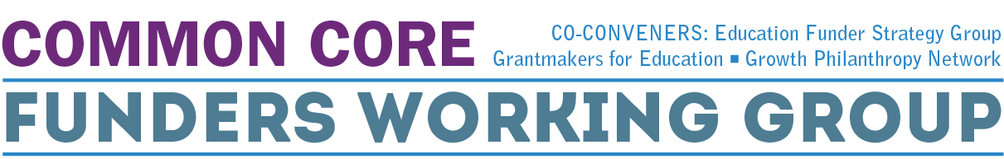
Supporting Common Core Implementation:
Scaling Effective Professional Development
Webinar #1
April 28, 2014
1:00-2:15pm ET

Slide 2
WELCOME
Notes:
GFE (plus 1-3 slides on series and ReadyTalk platform)

Slide 3
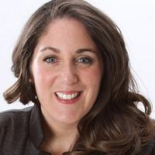

Lisa Relou
Director of Strategies
Grantmakers for Education

Slide 4
Founded in 1995, Grantmakers for Education is a membership organization of hundreds of grantmaking organizations across the nation working to improve outcomes and expand opportunities for learners across the education spectrum, from early learning through postsecondary and workforce development. Our mission is to strengthen philanthropy's capacity to improve educational outcomes and opportunities for all students. To accomplish this goal, we help foundation leaders and staff become more effective grantmakers by boosting their knowledge and their networks.
Gregg Behr
The Grable
Foundation
Cristina Huezo
W. Clement &
Jessie V. Stone
Foundation
Barbara Reisman
The Schumann
Fund for New Jersey
GFE is governed by a 12-member volunteer board of directors comprised of active foundation trustees and staff. Anne Stanton of the James Irvine Foundation is the current Chair and President of the organization, and Ana Tilton serves as GFE’s Executive Director.
Chair:
Anne Stanton
The James
Irvine Foundation
Nick Donohue
Nellie Mae
Education
Foundation
Barbara H. McAllister
Intel Foundation
Cassie Schwerner
The Schott
Foundation for
Public Education
Vice-Chair:
Wynn Rosser
Greater Texas
Foundation
Dominik Mjartan
Southern Bancorp Inc.
Tina Gridiron
Lumina
Foundation
Lee Parker
The Community
Foundation for the
National Capital Region
Lisa Villarreal
The San
Francisco
Foundation

Slide 5
Webinar Agenda
AGENDA ITEM
Welcome Lisa Relou – Director of Strategies, Grantmakers for Education
Introduction and Context Bill Tucker – Deputy Director, Policy Development, Bill & Melinda Gates Foundation
Highlights of Promising Professional Development Efforts and Reflections on Funder Support Stephanie Hirsh – Executive Director, Learning Forward Scott Hartl – President and CEO, Expeditionary Learning
Facilitated Questions and Answers: Panelists and CCFWG Issue Team Facilitated by Melissa Chabran – Senior Consultant, Education First
Closing: What is our role in supporting Common Core-aligned PD? Facilitated by Robert Sherman – Growth Philanthropy Network
Notes:
Welcome: Lisa Relou (3 minutes)
Welcome: Melissa Chabran (3 mins agenda and objectives) Bill Tucker, Introduction and Context (5 minutes Intro)
Stephanie (20 minutes for talking)
Facilitated Q&A (5 minutes for Q&A)
Scott (20 minutes talking)
Facilitated Questions and Answers (15 minutes)
Closing: Robert Sherman (7 minutes)

Slide 6
Webinar Objectives
As a result of participating in the program, funders will:
  Understand the on-the-ground perspective of what supports and help most teachers need for success as they start using Common Core standards in their classrooms
  Recognize high-quality efforts to support effective professional development through the use of background resources, proposal criteria to assess strength of proposals and insights from professional development leaders in the field
  Generate new ideas for funders to assist districts in providing high-quality, Common Core-aligned supports to their teachers
Notes:
Melissa runs through

Slide 7
INTRODUCTION
Notes:
Bill Tucker gives background on CCFWG Issue Team and frames conversation
10 minutes

Slide 8

GOALS
Clearly identify the emerging/pressing needs and gaps in the field as states and districts implement new standards and assessments
Match philanthropic resources with these gaps
Provide information to help individual funders (working at all levels—national, state and local) strengthen their own grantmaking strategies and choices as they work with specific states, districts, schools and critical stakeholders on the unique challenges and changes required as part of the shift to Common Core standards
Encourage coordinated grantmaking among funders with similar interests and strategies
Notes:
Bill Tucker talking points:
The CCFWG has several goals that drive the work including:
providing resources and information to funders,
addressing gaps in the field and
encouraging coordinated grantmaking among funders with similar interests
Working Group identified the priorities and interests of different funders, to aid collaboration and hone in on gaps in the field needing additional attention. Emerged with two issue teams (Ensure high-quality, common core tools, materials and resources and Scale effective, common core professional development)
This webinar focuses on helping grantmakers identify investments that focus on high quality Common core-aligned PD.
The PD issue team focuses on identifying and supporting effective, scalable practice in teacher training and development.

Slide 9
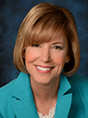
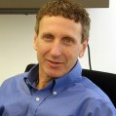
Presenters
Stephanie Hirsh
Executive Director, Learning Forward
Scott Hartl
President and CEO, Expeditionary Learning

Slide 10
HIGHLIGHTS OF PROFESSIONAL DEVELOPMENT EFFORTS
Notes:
Stephanie Hirsh, Learning Forward, followed by Scott Hartl, Expeditionary Learning
30 minutes

Slide 11
Stephanie Hirsh
Executive Director
Learning Forward

Slide 12


Slide 13
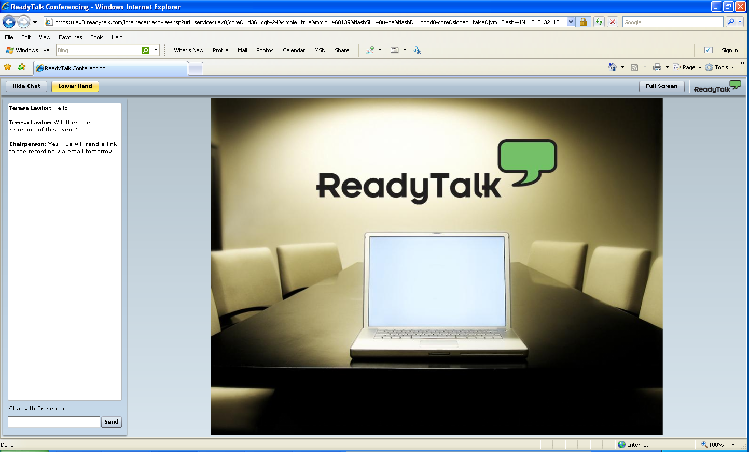
Participant Interface
Q&A
Type your question here and press ENTER

Slide 14
Scott Hartl
President & CEO
Expeditionary Learning

Slide 15

Building Teacher Capacity for the What and How of High-Quality Common Core Literacy Instruction
Supporting New Levels of College, Career and Civic Readiness

Slide 16
Our Mission
To create classrooms where teachers can fulfill their highest aspirations, and students achieve more than they think possible, becoming active contributors to building a better world.
Our Vision
When students and teachers are engaged in work that is challenging, adventurous and meaningful, learning and achievement flourish.

Slide 17
EL Professional Learning
Network of 165 Expeditionary Learning schools: Public district and public charter, K-12, urban, rural and suburban.
Common Core- aligned professional services for states, districts, CMO’s.
  Current partners include: New York State, Delaware, New York City, KIPP, TFA, Boston, Hartford

Slide 18
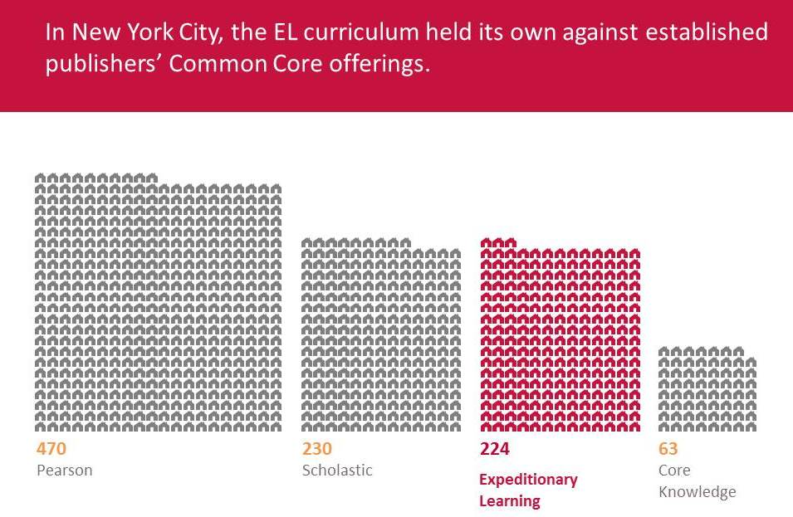
EL Common Core Literacy Curriculum
1,672,281 downloads
of EL’s common core curriculum materials from the EngageNY website.
Rated exemplary on the EQuIP Rubric by both Achieve and the State of Connecticut.

Slide 19
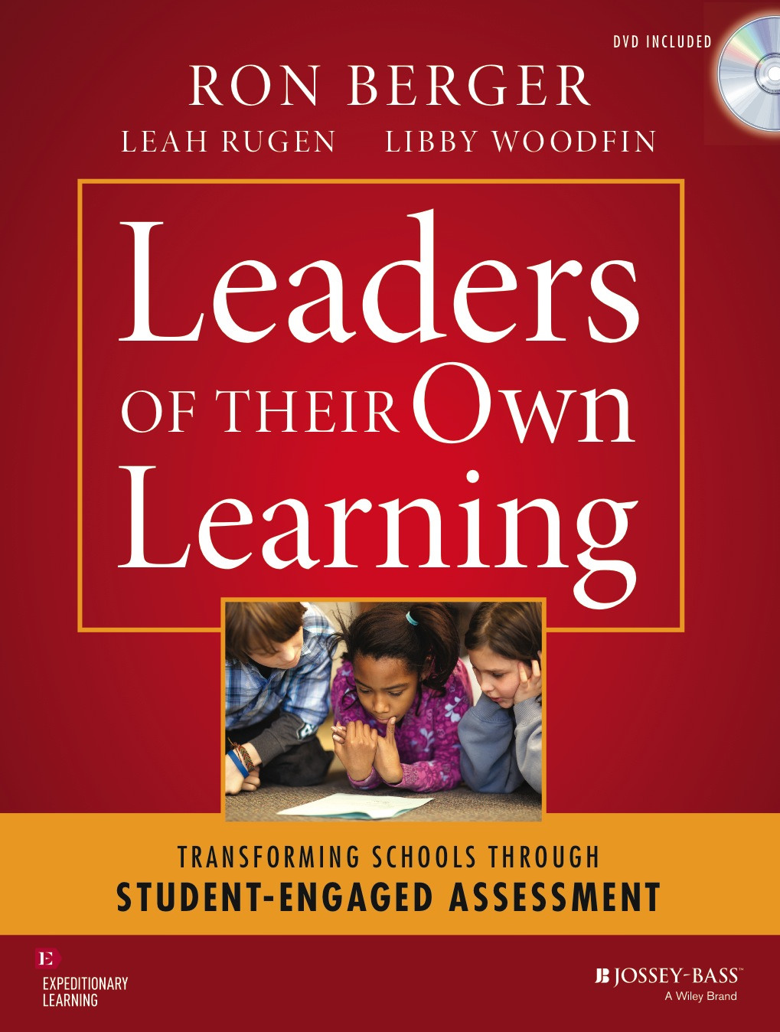
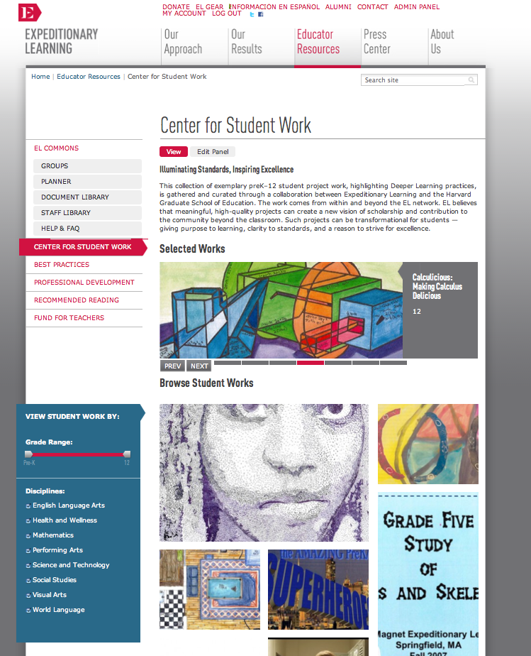
EL Instructional Materials

Slide 21
Building Capacity in the Field
New York State Partnership: EngageNY
  Building capacity through content plus coaching
  Ensuring sustained efforts through models and tools available both directly to schools and teachers and to those who also support professional learning in schools and for teachers
KIPP Partnership
  Similar approach, but using virtual tools to deepen the work
Notes:
We have been learning a great deal through our partnerships.
NYS
-- We have long been excellent providers of PD – But now we are experiencing a powerful multiplier effect as we build the capacity of others to deliver and develop effective professional learning. Content = paradigm shaking curricular models combined with video = literally showing teachers day by day how effective literacy instruction looks and even feels. Coaching (mention NTI) -- provided nearly 100 unique professional development workshops, some of which help users understand the principles behind effective PD and school change. Touches every district in the state. All materials, facilitator’s guides posted on EngageNY for use by schools and other PD providers. Somehow connect to i3 – expanding work with new teachers.
KIPP
-- In fall 2013, the KIPP Foundation engaged EL to support its Literacy for Everyone (LFE) initiative. LFE was designed by KIPP as an opportunity for schools to train one teacher and one instructional leader/coach to catalyze literacy achievement at their school sites. Similar in the approach – engaging their literacy and coaching terms in professional development directly, but also using virtual tools to sustain the work. EL’s reviews from these sessions were among the highest KIPP has ever received for PD from an outside organization.
EL has offered follow-up support via virtual office hours and running web-delivered consulting protocols to troubleshoot problems and answer participants’ questions. EL is also supporting KIPP in reviewing and providing feedback on LFE participants’ “homework” - videos of teachers in their buildings delivering close reading lessons, along with coaches’ observations. Using virtual tools has enabled us to…

Slide 22
Teachers’ Learning Needs
Unprecedented need
  Growing gap between teacher preparation and the field (i3)
  Scaling up
Time
  No fundamental shift in the school day or school year to support professional learning
Consistency
  Alignment of resources against the shifts
  Professional learning grounded in Common Core-aligned curriculum – instructional practices – assessment tools
Notes:
Need – substantial change in practice plus learning lag both amongst practictioners and those that teach practictioners.
Time – many teachers mentioning they are relearning everything they know – “liked getting another master’s degree” --
Mention the “wild west moment” – everything claiming to be “common core”

Slide 23
What Do Teachers Need to Make this Change?
A sea change in teaching and learning:
  A new paradigm of literacy instruction
    Complex text vs. leveled text
    Gradual release of responsibility vs. productive struggle
    Teacher-led vs. student collaboration
  Literacy beyond the ELA classroom
    Every teacher, every day
    Substantially increasing students’ volume of reading
  Building knowledge and skill simultaneously
    False dichotomy - learning to read vs. reading to learn
Notes:
This
The new paradigm of literacy instruction requires dismantling entire systems of literacy instruction – not just what teachers know but what they are using as resources for curriculum, instruction and assessment. Great deal of resource in the field that supports leveled literacy instruction, we are pushing up against explicit structures that prevent change. Literacy beyond the ELA classroom means that the total number of teachers who much learn and integrate new practices is exponentially larger. In addition we need to build and support structures that engage students in reading outside of obviously prescribed times. Finally, we are building new models of curriculum and curriculum design that show teachers that even young children benefit from reading “about” something – that kids can tackle meaningful content while they are also developing their skills. In fact, what we know is that meaningful content motivates students to read, write, and think in the way the standards require.

Slide 24
Recommendations to the Funding Community
Our work on the ground suggests that this is a field building moment and that high leverage opportunities for the philanthropic community include support for:
Exemplars (North Stars) - to inspire and guide
Research base – to convince and inform
Tools, resources, and understandings - to fuel scale (formal channels) and viral growth (informal channels)

Slide 25
For links to any of EL’s resources, to learn more about our i3 work, or for any follow-up that would be helpful, please email Scott Hartl at shartl@elschools.org
www.elschools.org

Slide 27
Participant Interface
Q&A
Type your question here and press ENTER

Slide 28
Summary and Closing
What Is Our Role in Supporting Common Core Aligned Professional Development?
Notes:
Robert Sherman, Growth Philanthropy Network
7 minutes

Slide 29
Locating Webinar Materials
http://www.edfunders.org/common-core

Slide 30

Next Up on GFE Common Core Webinar Series…
Notes:
Melissa or Robert

Slide 31
Upcoming Webinar Topics:
Date | Topic
May 27 | “Ensuring Aligned and Effective Instructional Materials”
Notes:
Melissa or Robert

